Slide 1
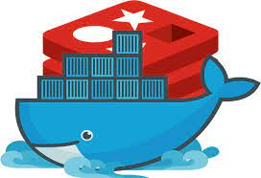
Containers with Docker

Slide 2

Overview _ what we will cover ?
What is Docker ?
What is an Image ?
What is a container ?
Docker Architecture
Container vs VM
Docker Networking
Docker Compose
Docker Volumes and Data Persistence
Demo project
Develop with Containers
Run multiple containers - Docker Compose
Build own Docker Image - Dockerfile
Push to private Docker Repository
Deploy containerized application
Persist data in Docker - Volumes

Slide 3
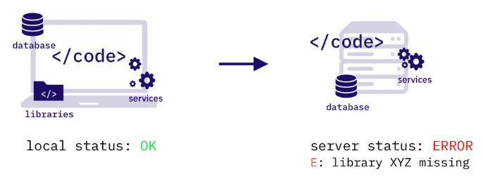
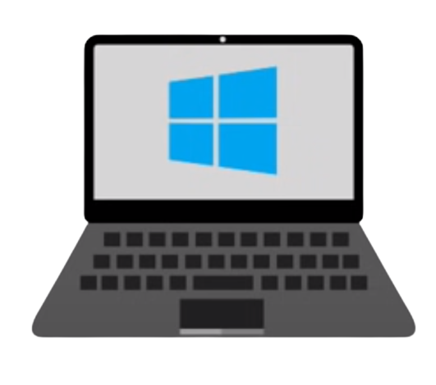
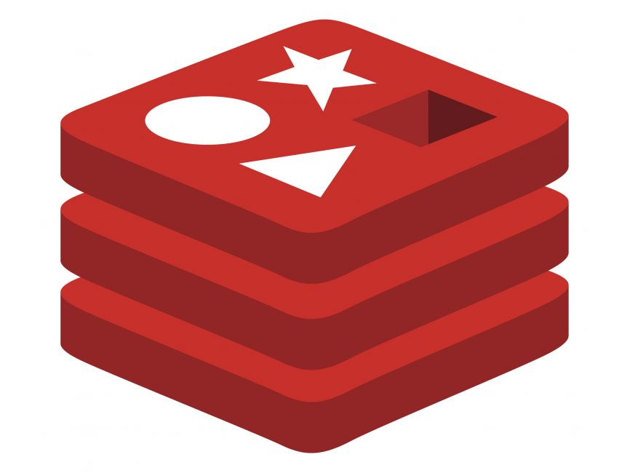

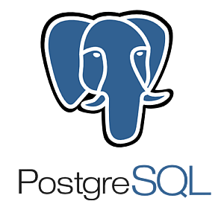
Challenges of Traditional deployment of applications
Redis
V 5.0
Redis
V 5.0
V 9.3
V 9.3
Notes:
In the traditional model, deploying applications was often a complex and error-prone process. Developers would write code on their local machines, which worked perfectly in their specific environment. However, when the time came to move this application to a testing or production environment, things would often fall apart.
Why? Let's Explore the Challenges:
Inconsistent Environments: Developers, testers, and production servers often ran different operating systems and had different configurations. This inconsistency led to the infamous “but it works on my machine!” syndrome.
Dependency Hell: Applications depend on specific versions of libraries and tools. Ensuring that the exact versions are installed on every machine across different stages of development and deployment was a nightmare.
Resource Intensive: Traditional deployments often relied on virtual machines, which are heavy and consume a significant amount of resources. This resulted in inefficient utilization of hardware and increased costs.
Slow Deployments: The process of setting up a new environment, configuring it, and ensuring all dependencies are correctly installed was time-consuming, slowing down the entire development and deployment pipeline.
The challenges of traditional application deployment highlighted the need for a solution that provides consistency, efficiency, and independence from the host OS.

Slide 4
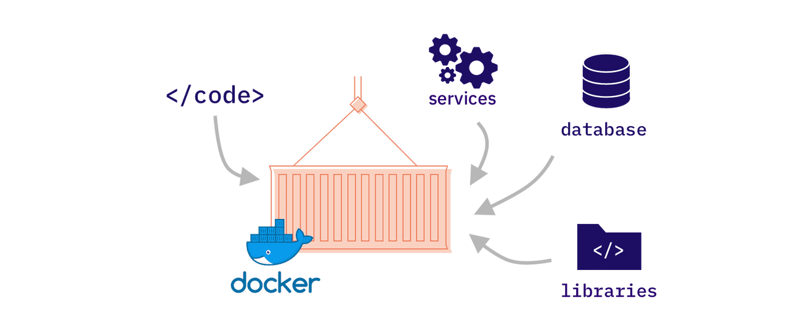
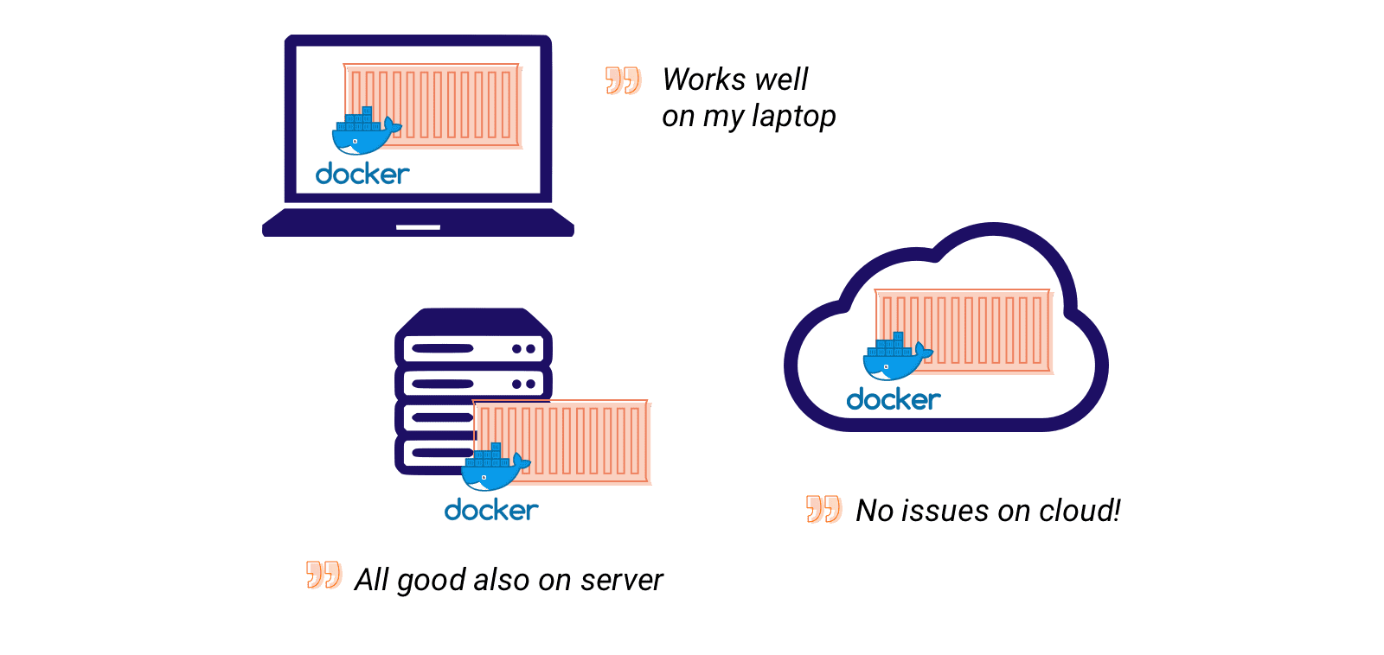
What is Docker?
Notes:
In this landscape of inconsistency, inefficiency, and frustration, the need for a solution like Docker became evident.
Docker is a powerful platform that has revolutionized the way developers work. It allows us to package our applications and their dependencies together into a single unit called a container. This container can run on any machine that has Docker installed, regardless of the underlying operating system. This means that the 'it works on my machine' problem is a thing of the past. With Docker, you can be confident that if it works on your laptop, it will work in production as well
Docker is an open platform for developing, shipping, and running applications. Docker enables you to separate your applications from your infrastructure so you can deliver software quickly. With Docker, you can manage your infrastructure in the same ways you manage your applications.

Slide 5
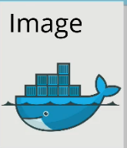
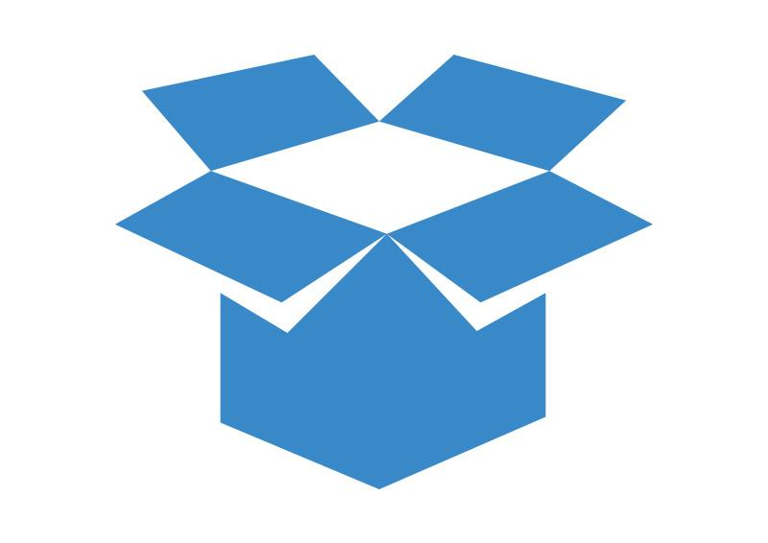
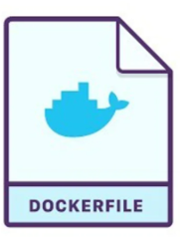
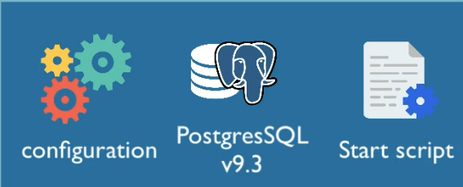



What is an Image ?
build
Package your application
blueprint
Artifact that can be moved around
push
Pull from repositories
Developer
Notes:
A Docker Image is essentially a blueprint for running applications. But it’s much more than just A stack of layers which are created from sequential instructions on a Dockerfile ; it's a packaged unit that contains everything your application needs to run: the code, runtime, libraries, environment variables, and config files. It’s like having a box that contains every single ingredient and tool you need to make your application work.
Think of a Docker Image as a snapshot of your application in a specific moment, frozen in time and yet ready to be brought to life at any moment. And the beauty of it? Consistency. Whether you run it on your laptop, a friend’s computer, or a server halfway across the world, it will always run the same way.
But how do you create a Docker Image? You start with a Dockerfile. This Dockerfile is a script containing a set of instructions on how to build your Docker Image. Once you’ve defined your Dockerfile, you use the docker build command, and Docker takes care of the rest, creating a reusable Docker Image for you.
A Docker Image, once created, is a standalone package that contains everything your application needs to run. But how do we share this image with other developers, or deploy it across different environments? That’s where Docker repositories come into play.
Docker Repositories provide a centralized, secure location to store and share Docker Images.
Services like Docker Hub and Amazon ECR simplify the process of managing and deploying Docker Images.
The accessibility and portability provided by these repositories ensure a seamless, consistent development and deployment experience for developers across the globe.
Developers around the world can 'publish' their Docker Images to this library, making them accessible to anyone who needs them.
When a developer wants to use a specific image, they simply 'pull' it from the repository to their local machine.

Slide 6
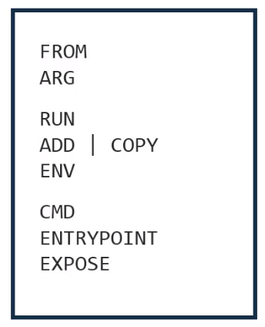
Dockerfile structure
ARG CODE_VERSION = 17-alpine
FROM node:${CODE_VERSION}
WORKDIR /app
RUN npm install
COPY . .
EXPOSE 4000
CMD [“node”, “app.js”]
Fundamental Instructions
Configuration Instructions
Execution Instructions
Notes:
Now, let's look at the structure used for writing the Dockerfiles.
Firstly, it is a file with no extension at all! And a general rule of thumb is to name the file as "Dockerfile"
with "D" capital and no extension.
You can use any text editor to create the file.
Just make sure you don't put an extension.
The purpose behind doing so is to make the file compatible to parse for auto builder used by docker to build the images.
What you see inside the Dockerfile are instructions to be passed on. The instructions can be generally divided into three categories: fundamental, configuration, and execution instructions.
1. ARG CODE_VERSION=17-alpine
This line defines a build argument named CODE_VERSION.
A build argument allows you to pass values that can be used during the image build process.
Here, we’re setting CODE_VERSION to 17-alpine, meaning we intend to use version 17 of the Node.js Alpine image.
2. FROM node:${CODE_VERSION}
This line tells Docker to start building our image based on the Node.js Alpine image, version 17.
The ${CODE_VERSION} part uses the value we set in the ARG instruction.
Alpine versions are smaller and more lightweight, making our image more efficient.
3. WORKDIR /app
This sets the working directory inside the container to /app.
Any subsequent commands will be run in this directory, and any relative paths will be relative to this location.
4. COPY . .
This copies all files from the current directory on the host machine (where the Dockerfile is located) into the current working directory inside the container.
5. RUN npm install
This runs npm install inside the container, installing the Node.js application’s dependencies based on the package.json file.
6. EXPOSE 4000
This tells Docker that our container will use port 4000.
It doesn’t actually publish the port; it serves as documentation to indicate which ports the container is intended to use.
7. CMD [“node”, “app.js”]
This sets the default command to run when the container starts.
Here, it’s running node app.js, starting our Node.js application.
Understanding Docker Layers:
Each instruction in our Dockerfile creates a layer in the Docker image.
Layers help optimize Docker, as they are cached and reused if no changes are detected in that layer.
For example, if we change our application code, the COPY . . layer and everything after it would be rebuilt. However, the layers before it (setting up Node.js and the working directory) would be reused from the cache.

Slide 7
Docker image layers
CMD Layer
Expose Layer
Layers
WORKDIR Layer
Run Layer
Base Image Layer
Pull the base / parent image from docker Hub
Unique image ID
Convenient name
Tag
bootfs
Notes:
The layers are "Read-Only". Although that is an exception of the topmost layer which is "Read-Write" type
but we will get into that later.
The docker images can be recognized either by their "unique image ID" which is provided by docker or a
convenient name or tag,
which is provided by us means users.
to visualize the layers of a docker image, they would stack up like this.
We start with the boot file system, which is pretty much similar to Linux's own boot file system.
It is an arrangement of "cgroup", "namespaces", and "resource allocation" which virtually separates the
image from the rest of the files on the host or cloud.
On top of that, we would have base image layer which along with the layers above it will follow the file mapping
laid out by boot file system layer.
Next, we have layers such as "work directory", "environmental variables",
"Add", "Copy", "Expose", "CMD" etc..

Slide 8
Docker commands for images
// List all local docker images
docker images Or docker images ls
// Build the docker image from the dockerfile
docker build -t <image_name> <path_to dockerfile> .
// Download an image from docker Hub
docker pull <image_name>:<image_version>
// Remove an image
docker rmi <image_name>
// Remove all unused images
docker image prune

Slide 9
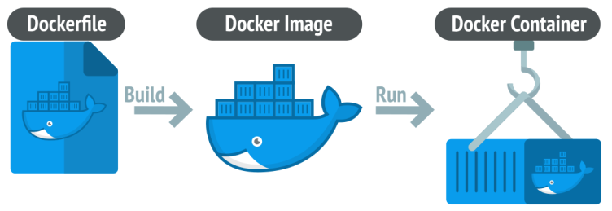
What is a container ?
Notes:
Alright, now that we've grasped what Docker Images are, let's move forward and unravel the mystery of Docker Containers.
When you decide to run this image, that’s when the magic happens. You issue a command, and Docker takes this image, unpacks it, and breathes life into it. What you get is a Docker Container.
From Image to Container:
as you see in this process :
You have your Docker Image, a perfect snapshot of your application.
You run a container from this image. Now, your application is live and running.
This container is a living entity. You can interact with it, modify it, and it will respond in real-time.
So, in essence, Docker Containers are the living, breathing versions of your application. They take the perfection of Docker Images and turn it into actionable, runnable entities, ensuring consistency, efficiency, and portability across the entire application lifecycle."
Benefits of Using Containers:
Portability: Since containers include everything needed to run your application, they can move seamlessly across different environments.
Isolation: Containers provide a secure and isolated environment for your applications, ensuring that they run consistently and reliably.
Efficiency: Containers are lightweight and fast, making better use of your system resources.

Slide 10
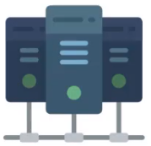
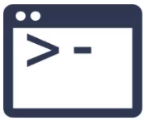

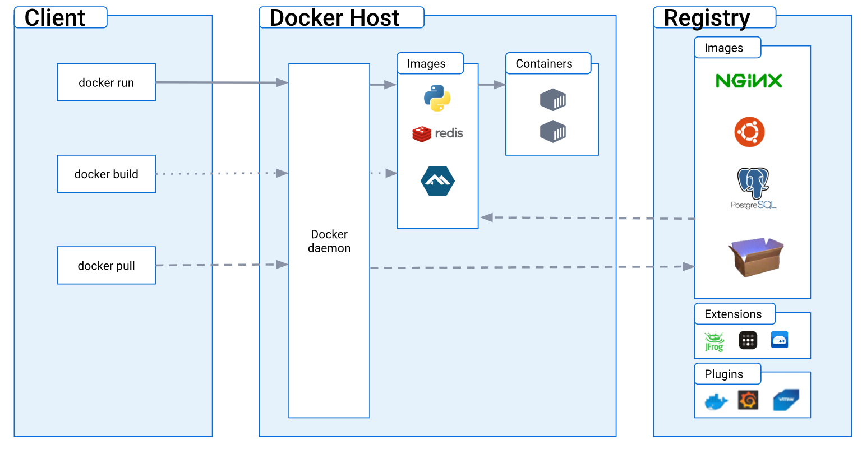
Docker Architecture
Notes:
Imagine you're an architect. Every building you design starts with a blueprint, a detailed plan that guides construction. In Docker's world, this blueprint is called an Image. It contains all the necessary details, tools, and configurations to bring an application to life. Just like you can't live in a blueprint, you can't run an image. It's static and unchanging.
Now, let's say you decide to take that blueprint and build a house from it. That house, once constructed, is something you can live in. It's dynamic and functional. In Docker, when you 'build' an image, it becomes a Container. A container is a running instance of that blueprint or image. Just like multiple houses can be built from the same blueprint, many containers can be run from the same image.
However, building many houses requires coordination, management, and a plot of land to put them on. In Docker's world, this 'land' where everything gets built and managed is called the Docker Host. Overseeing the construction on this land is the site manager, or in Docker terms, the Docker Daemon. The Daemon ensures everything runs smoothly, managing the life cycle of containers, building from images, and ensuring resources are appropriately allocated.
Now, where do these blueprints or images come from? Just as architects store their blueprints in a secure vault or a library, Docker images are stored in a Docker Registry. This registry is a vast library where you can find various application blueprints. You can fetch or 'pull' blueprints from this library or even store or 'push' your custom blueprints for others to use.
And how do you, the architect, communicate your wishes to the site manager or Docker Daemon? Through a walkie-talkie or, in Docker terms, the Docker Client. Every time you issue a command like 'build this image' or 'run this container,' you're using the Docker Client to relay instructions to the Docker Daemon.
In essence, the Docker universe is like a bustling construction site. Images are the foundational blueprints, containers are the living homes built from those blueprints, the Docker Daemon is the site manager ensuring everything runs smoothly, and the Docker Registry is the grand library of all possible blueprints
******************************************************************************************************************
Storytelling Explanation of Docker's Architecture: The Cooking Analogy
"Imagine you're about to prepare a feast. Every dish you want to make starts with a Recipe. This recipe lists down all the ingredients, quantities, and steps to whip up a dish. In Docker's world, this recipe is what we call an Image. It’s the set of instructions and ingredients needed to make a specific dish or, in tech terms, to run an application.
However, a recipe by itself is just a piece of paper. To actually taste the dish, you need to cook it. When you follow the recipe's steps and use its ingredients, you get a dish ready to be served and eaten. In Docker, when you 'cook' or execute an image, you get a Container. Just as one recipe can be used to prepare multiple servings of a dish for different guests, you can create multiple containers from a single image.
But where do you cook? You need a kitchen, right? In Docker, this 'kitchen' where all the action happens is the Docker Host. Now, managing this kitchen is the head chef, who ensures that every dish is cooked perfectly and served on time. This head chef in the Docker universe is the Docker Daemon. The Daemon keeps an eye on the containers, ensuring they're running smoothly, and manages the resources they use.
Now, where do you get these recipes? From a cookbook or a recipe website! This is the Docker Registry in our story. It's a vast collection of images (or recipes) that you can choose from. You can 'download' or 'pull' recipes from this collection, and if you create a new dish yourself, you can 'upload' or 'push' your recipe to this collection for others to use.
Lastly, how do you tell the head chef what to cook? You give them instructions, right? In Docker, you communicate with the Daemon using the Docker Client. Every time you want to cook a dish (run a container) or check on its status, you're using the Docker Client to talk to the Daemon, just as you'd instruct a chef in a kitchen.
In summary, the world of Docker is a lot like a grand, bustling kitchen. Recipes (Images) guide the creation of dishes (Containers), the kitchen (Docker Host) is where the magic happens, the chef (Docker Daemon) oversees everything, and the cookbook (Docker Registry) is the source of all culinary inspiration."
This cooking analogy provides a relatable and easy-to-understand representation of Docker's architecture, especially for those who enjoy culinary arts or just love food!

Slide 11
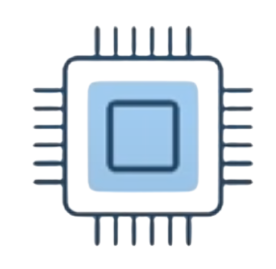


Containers versus Virtual Machines
Applications
Applications
VM
Container
Guest OS
Libs
Hypervisor
Docker Daemon
Host OS
Host OS
Hardware
Hardware
Emulate a complete OS.
Isolated at the hardware level
Less portable across environments.
Slightly lower performance.
Share the host OS kernel
Use OS-level isolation mechanisms.
Highly portable across environments.
Suitable for microservices.
Notes:
Having explored the intricacies of Docker’s architecture, let’s now compare Docker Containers with another widely used technology: Virtual Machines, or VMs.
Docker is ”sort of ” a virtualization technology, but not exactly
Resources are shared with the host => many containers on one server
Virtual Machines:
A VM is like a computer within a computer. It runs its own operating system, and it emulates all the hardware components. This makes VMs highly isolated and secure.
However, this emulation comes with overhead. VMs are heavier, they take more time to start, and they consume more resources.
VMs provide strong isolation at the hardware level, and they are a good fit for running entirely different operating systems or for situations where you need full control of the virtualized hardware.
Docker Containers:
On the other hand, Docker Containers are more like apartments in a building. They share the same infrastructure, the host OS kernel, but they have their own private space and resources.
Containers are lightweight, they start almost instantly, and they are highly efficient in terms of resource usage.
They provide OS-level isolation, which is generally enough for most applications, making them a perfect fit for microservices and cloud-native applications.
Comparing the Two:
When it comes to portability, Containers take the lead. Since they carry their dependencies with them, they can move seamlessly across different environments.
In terms of performance, Containers also generally have an edge, thanks to their lightweight nature and faster start times.
However, if you need strong isolation at the hardware level or you need to run multiple OS types, VMs might be the better choice.
In Summary:
Containers are like agile, efficient apartments, perfect for microservices and cloud-native applications.
VMs are like independent houses, offering strong isolation and versatility, but with more overhead.
Your choice between Containers and VMs should be driven by your specific use cases, performance requirements, and isolation needs.
Understanding this comparison is crucial as it helps in making informed decisions about when to use Docker Containers and when to opt for Virtual Machines."

Slide 12
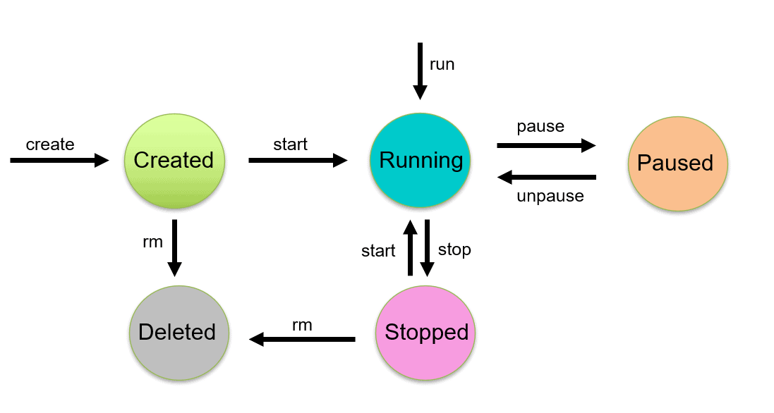
Docker Container Lifecycle
Notes:
To work with Docker efficiently, it is essential to comprehend the various stages of a container's existence, which is called its `lifecycle`. The Docker container lifecycle is comprised of several states, such as `created`, `running`, `paused`, `exited`, and dead
Summary of these states before we deep dive into it:
created - This is the initial state of a Docker container after it has been created, but before it has been started.
running - When a Docker container is started, it transitions to the running state. In this state, the container is actively executing its processes.
paused - If a container is paused, it is temporarily stopped from running its processes, but it is not terminated.
exited - If a container's main process completes, the container stops and transitions to the exited state.
dead - If a container fails to start, it is in the dead state. Containers in this state cannot be restarted and must be recreated.

Slide 13
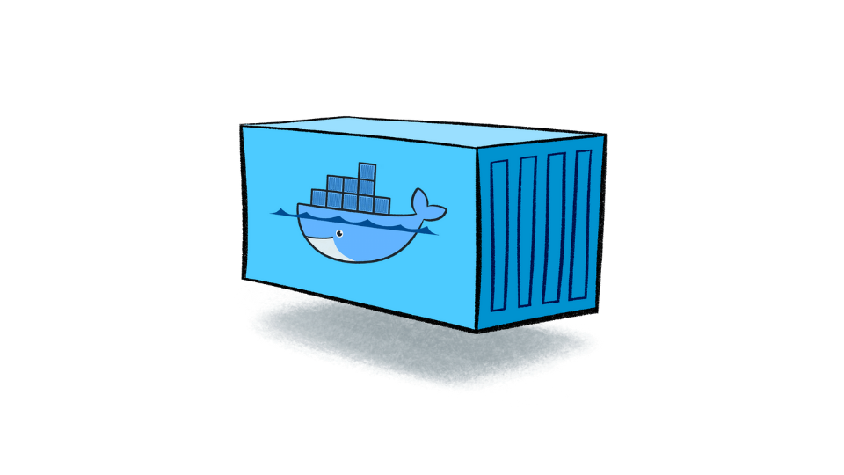
Docker commands for container lifecycle
// Start a stopped container
docker start <container_name/id>
// Stop a running container gracefully
docker stop <container_name/id>
// Forcefully stop a running container
docker kill <container_name/id>
// Restart a stopped container
docker restart <container_name/id>
// Remove a stopped container
docker rm <container_name/id>
// List all local docker containers
docker ps or docker container ls
// Run the docker image
docker run --name <container_name>
-p 4001:4000 -d <image_name>
Local host
port ( external)
Container port ( internal)

Slide 14
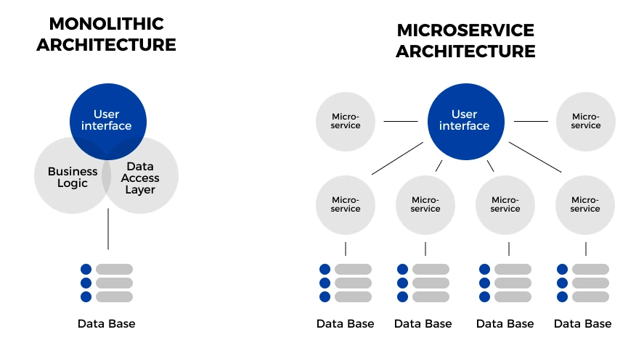
Multi-Container Applications
Catalog
Shopping cart
Discount
Ordering
Notes:
Having just explored the fascinating lifecycle of a Docker container, let’s now delve into a practical application of multi-container environments using an Online Shop as our example.
Monolithic vs Microservices:
Imagine initially building our online shop as a monolithic application, where Catalog, Shopping Cart, Discount, and Ordering functionalities are all intertwined in a single codebase. While this might seem straightforward at first, it quickly becomes a bottleneck as our application grows.
Challenges with Monoliths in E-commerce:
Single Database: All modules interact with the same database, leading to potential bottlenecks and complex database management.
Uniform Programming Language: All parts of the application must be written in the same programming language, which can limit innovation and adaptability.
Development and Deployment Challenges: Multiple developers working on the same codebase can lead to conflicts. Moreover, a small update in one module requires redeploying the entire application, introducing risk and potential downtime.
Scalability: Consider a Black Friday sale; the traffic surge requires more resources, especially for the Catalog and Shopping Cart services. In a monolith, we’d frustratingly find ourselves needing to scale the entire application, even the parts not under heavy load.
Transition to Microservices: A Breath of Fresh Air:
Now, imagine breaking down our online shop into distinct microservices, each responsible for a specific functionality:
Catalog Service: Manages product listings. Could use a high-performance NoSQL database.
Shopping Cart Service: Handles user’s cart operations. Might interact with a fast, in-memory database.
Discount Service: Calculates discounts. Could use its own database to track promotional events.
Ordering Service: Manages orders and payments. Might require a transactional database.
Each microservice can be developed in the most suitable programming language for its specific needs and can interact with its own dedicated database.
Microservices in Docker Containers:
These microservices live in their own Docker containers, providing isolation, scalability, and consistency.
Docker ensures that each microservice has its required environment to run, regardless of where the container is deployed.
Benefits for Our Online Shop:
Targeted Scalability: Each service can be scaled independently, providing resources exactly where needed.
Faster, Safer Deployments: Updates to a specific service can be deployed independently, reducing risk.
Development Agility: Different teams can work on different services simultaneously, leading to faster innovation.
The Journey Ahead:
Having understood the power of microservices and multi-container applications, our next step in this journey is exploring Docker Networking.
This will unveil how these independent services in their respective containers communicate with each other to form a seamless, integrated online shopping experience.

Slide 15
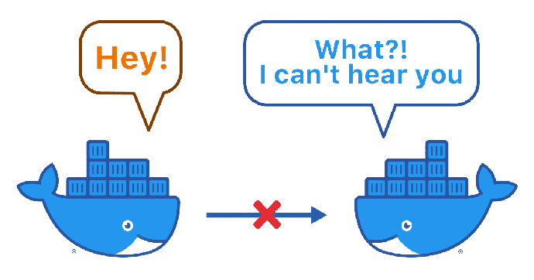
Docker Networking
Bridge Network: Like a Private Club
Host Network: Sharing the Stage
It’s like a private network in your system, perfect for containers that need to talk to each other on the same host.
Example: Imagine you have two apps on your laptop, one showing weather and another showing news. They use the Bridge Network to share information and give you a combined weather-news update.
The Host Network is like giving a container a VIP pass to use the same network your computer is using. It’s super-fast because there’s no middleman.
Example: You have a high-speed trading app in a container. It uses the Host Network to get stock prices as fast as possible.
Overlay Network: Long-Distance Calls
None Network: Total Isolation
long-distance call between containers on different computers. Even if they are far apart, they can still talk to each other.
Example: Your app is so popular that it’s running on many computers in different places. The Overlay Network helps parts of your app on one computer talk to parts on another.
The None Network is for containers that want to be left alone. They don’t talk to anyone, not even other containers.
Example: You have a container doing complex math calculations. It doesn’t need the internet or to talk to other apps, so it uses the None Network.
Notes:
let’s now demystify the critical component that binds these containers together: Docker Networking.
In the realm of Docker, containers need to communicate for various reasons: A backend service might need to fetch data from a database, or two services might need to exchange information. Docker Networking makes all of this possible, acting like a well-designed road system in a city, guiding data to the right destination.
It’s about creating a harmonious environment where data flows seamlessly, from the Catalog to the Shopping Cart, through the Discounts, and finally, to the Ordering service.
Why Names and Not IP Addresses?
In this Docker city, containers have both names and IP addresses. But when it comes to communication, we prefer using names. Why? Because names are stable. They don’t change. IP addresses, however, can change whenever a container is restarted, making them unreliable for consistent communication.
This simplicity is a game-changer. It means less hassle with configurations, making the whole system more robust and easier to manage.
The Power of Docker Networking
With Docker Networking, we say goodbye to the tedious task of managing IP addresses. Everything is designed to be straightforward, reliable, and scalable.

Slide 16
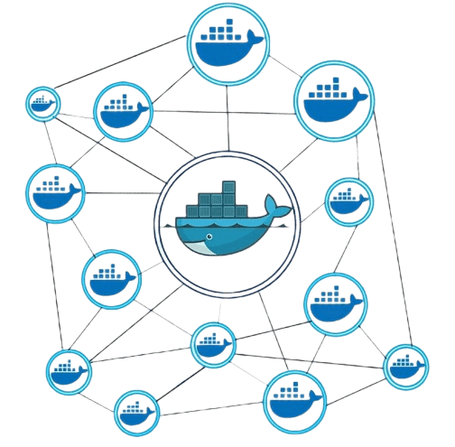
Docker commands for networks
// Create a user-defined network
docker network create <network_name>
// List networks
docker network ls
// Connect a container to a network
docker network connect <network_name> <container_name/id>
// Disconnect a container from a network
docker network disconnect <network_name> <container_name/id>

Slide 17
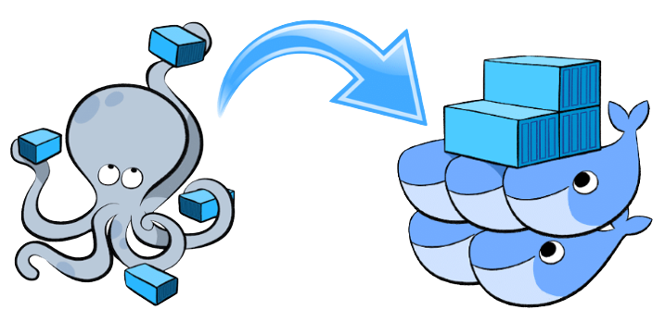
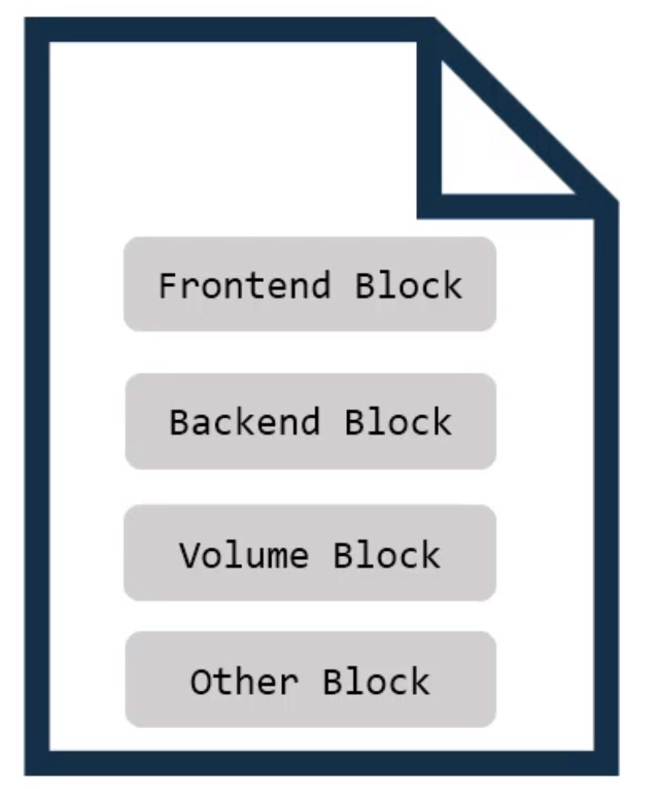

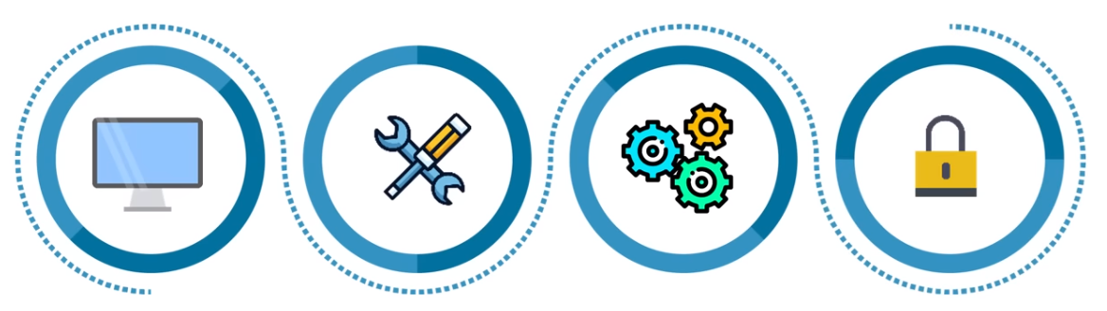
Docker Compose
A yaml compose file
Frontend dockerfile
Backend dockerfile
Database dockerfile
Single host deployment
Quick and easy configuration
High productivity
Security
Notes:
Armed with this knowledge of Docker Networking, we’re now ready to explore Docker Compose, a tool that will simplify the management of multi-container applications, ensuring our containers are networked and configured just as we need them to be.
The Heart of Docker Compose: docker-compose.yml
At the center of Docker Compose is the docker-compose.yml file. This is where the magic happens. We define our services, networks, and volumes, all in one place, using YAML, a human-readable data serialization standard.
A Practical Example: Web Application
Imagine setting up a web application. You have a backend service talking to a database, and a front-end displaying data. With Docker Compose, you define these services, their networks, and volumes in your docker-compose.yml, ensuring they work together seamlessly.
One of its pivotal advantages is its facilitation of Single Host Deployment, enabling users to manage and orchestrate all their containers on a single machine, which significantly simplifies the complexity associated with network configurations and inter-container communications. This simplicity extends to its Quick and Easy Configuration capabilities, as Docker Compose allows users to define their entire application stack, including services, networks, and volumes, in a single, straightforward YAML file. This not only makes setting up and modifying configurations a breeze but also ensures consistency across different stages of development, testing, and production. The tool's nature inherently boosts Productivity, as developers and operators can initiate, replicate, and tear down entire environments with just a few commands, leaving more time for innovation and optimization. Moreover, Docker Compose doesn’t compromise on Security, as it supports the isolation of applications in containers, ensuring that each component operates in its confined environment, reducing the risk of interference and potential security breaches. Together, these benefits position Docker Compose as a powerful ally in the orchestration of Docker containers, ensuring a smoother, more efficient, and secure development lifecycle."

Slide 18
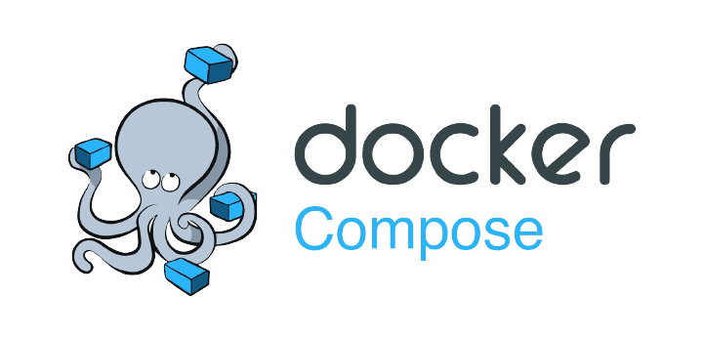
Docker commands for Compose
// Start services defined in docker compose file
docker-compose up
// Stop and remove services defined in docker compose file
docker compose down
// List services in compose file and their status
docker compose ps
// View logs for a specific service
docker compose logs <service_name>
// Run a command in a running service container
docker compose exec <service_name> <command>

Slide 19
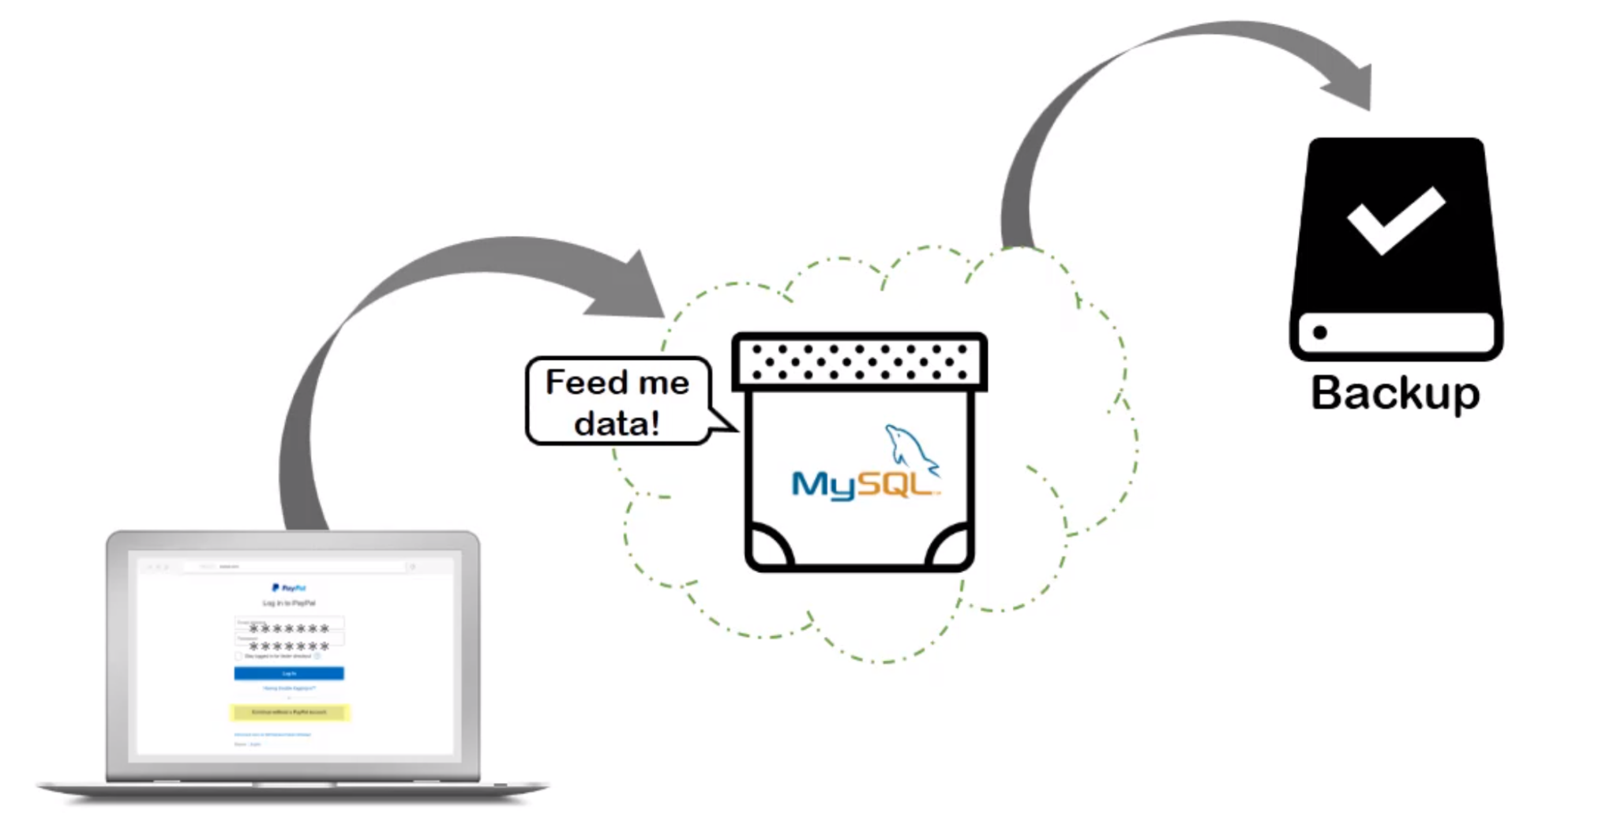
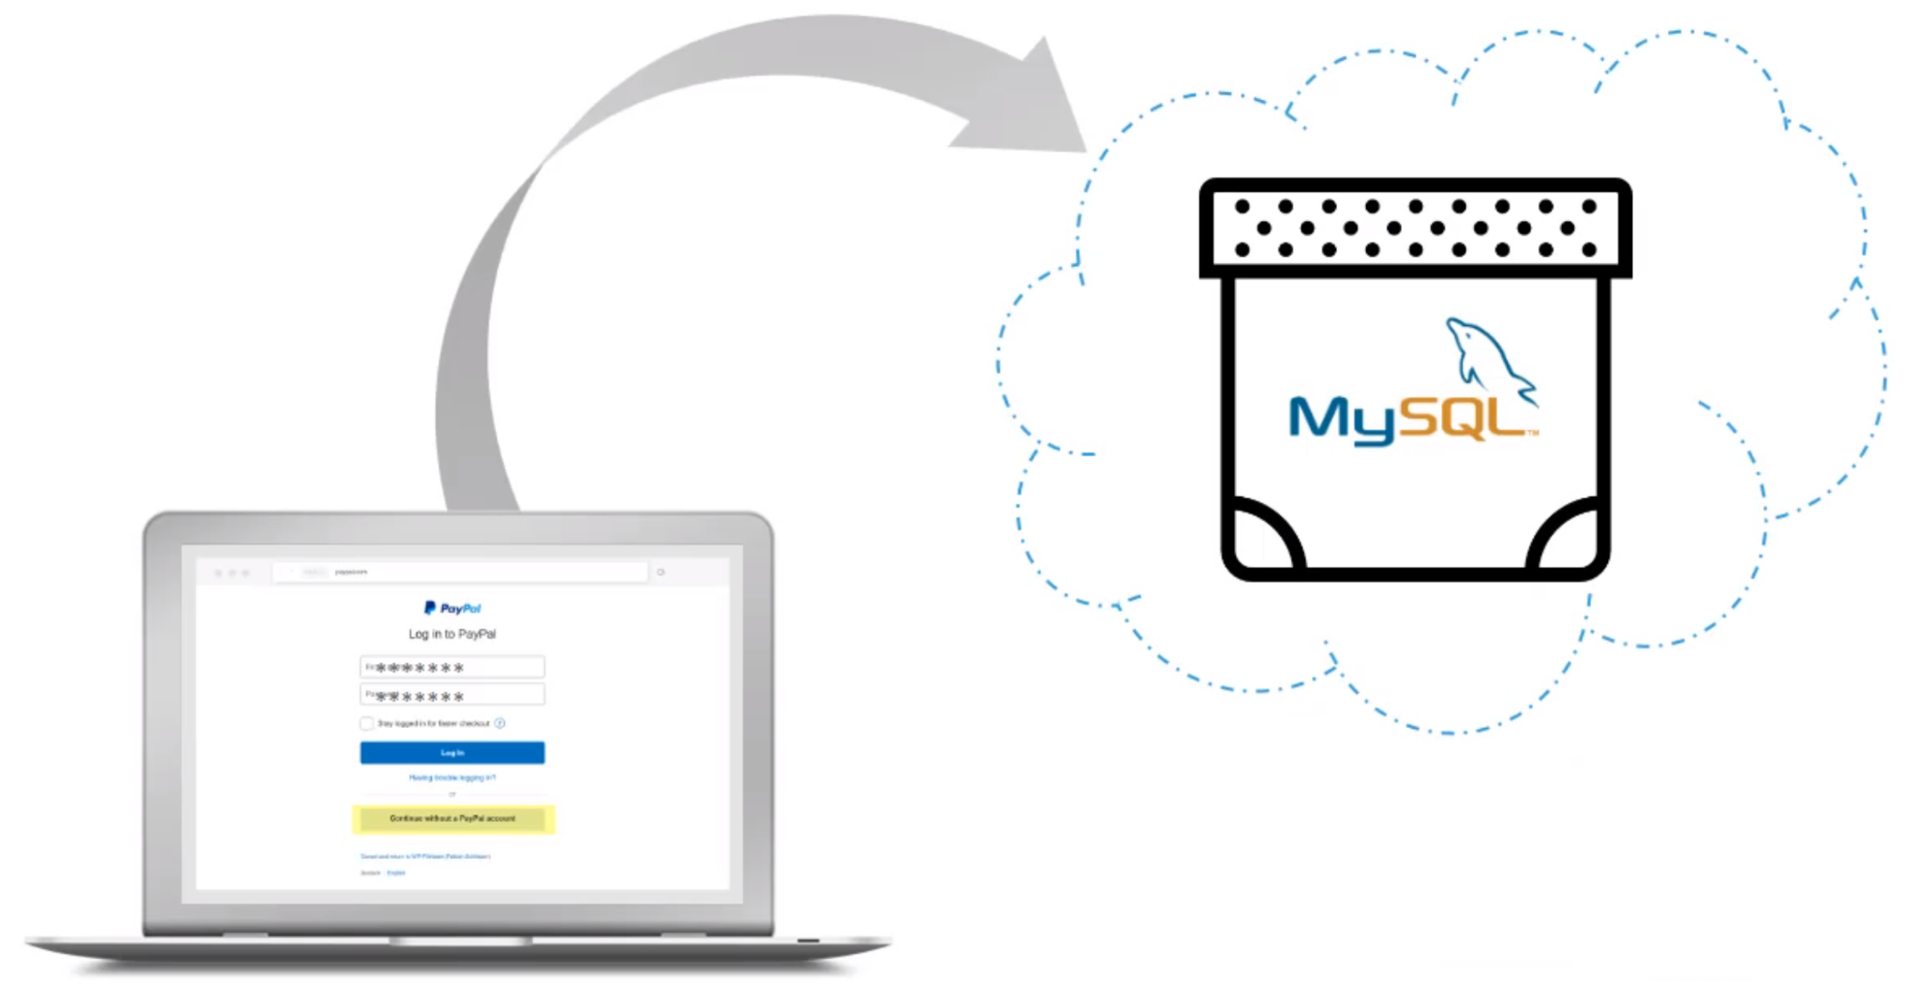

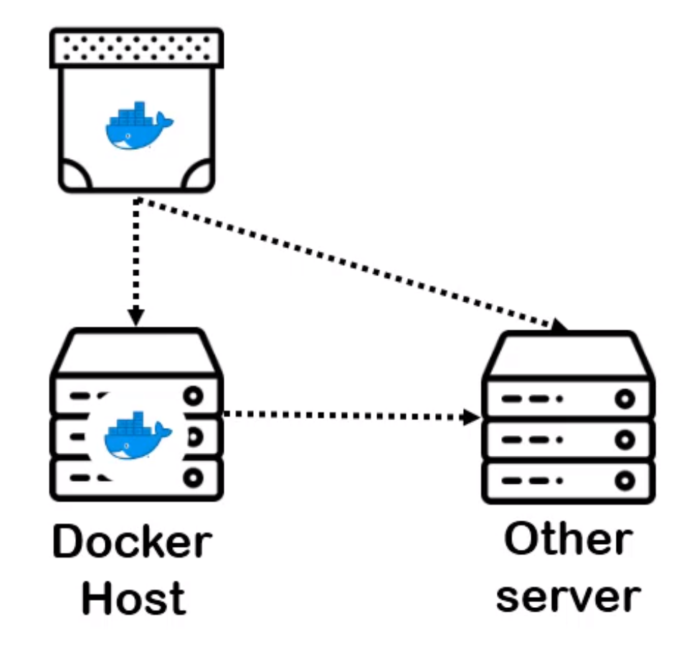
Docker Volumes
Loss of Critical User
Data Interruption in Service and Downtime
Compromised Data Integrity and Reliability
Where to store the backup ?
Notes:
1. Loss of Critical User Data
Scenario: Imagine you are running a containerized PostgreSQL database for an e-commerce website.
Risk: If the database container crashes or needs to be updated, and it's not using a Docker volume, all the data inside the container’s writable layer is lost.
Impact: User accounts, transaction history, product information, and other critical data are permanently lost. Customers can't access their accounts, ongoing transactions are interrupted, and the integrity of the website is compromised. The business could suffer significant financial losses and damage to its reputation.
2. Interruption in Service and Downtime
Scenario: The same e-commerce website relies on real-time inventory management.
Risk: Without a Docker volume, if the database container goes down, inventory data is lost, leading to discrepancies in stock levels.
Impact: The website might display incorrect inventory information, leading to overselling or inability to fulfill orders. This results in customer dissatisfaction, potential loss of sales, and additional operational overhead to rectify the discrepancies, leading to prolonged service downtime.
3. Compromised Data Integrity and Reliability
Scenario: The e-commerce platform also manages customer reviews and ratings for products.
Risk: Without persistent storage through Docker volumes, customer reviews and ratings are lost if the database container is restarted.
Impact: The loss of user-generated content can lead to a lack of trust in the platform, as products appear to have no reviews or ratings. New customers might be hesitant to make purchases, and the overall reliability of the platform is compromised.
Where to store the backup ?
Using another server or a separate Docker host for storing backups provides an additional layer of security and reliability. By isolating backup data from the primary system, we safeguard critical information and ensure a swift recovery process in case of failure or data corruption. This approach enhances data integrity and resilience, making it a strategic choice for robust disaster recovery planning and continuous data availability.

Slide 20
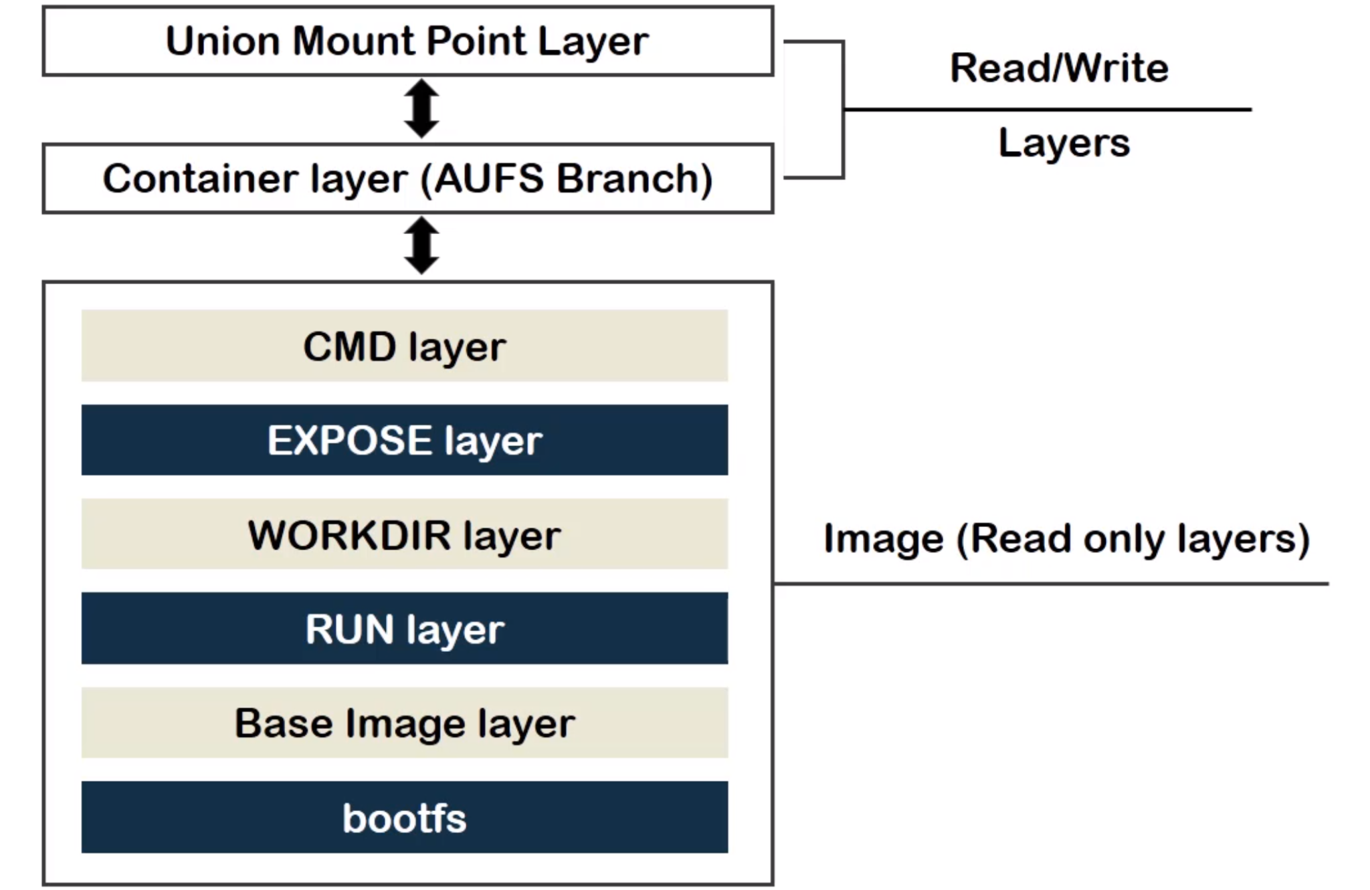
Volatile Data
Permanent Data
Notes:
your mind would be, what or which the data should be backed up? To answer that, we need to look back at
the layered structure of docker image and container data.
If you remember, we have two types of layers: "read only layer", which hold permanent data and is never modified
due to Copy-on-Write policy and "read-write layers" which hold temporary or volatile data.
If a container stops or dies, the volatile data vanishes.
So now, we have our answer!
We need to back up the important data from the volatile read-write layer of the container.

Slide 21
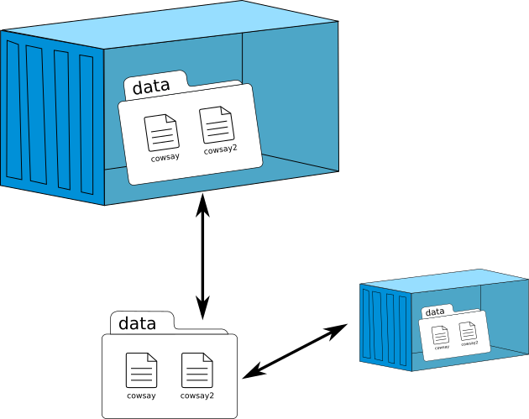
Docker commands for volumes
// Create a named volume
docker volume create <volume_name>
// Mount a volume to a container
docker run -v <volume_name>:<container_path>
// List volumes
docker volume ls
// Remove a volume
docker volume rm <volume_name>

Slide 22
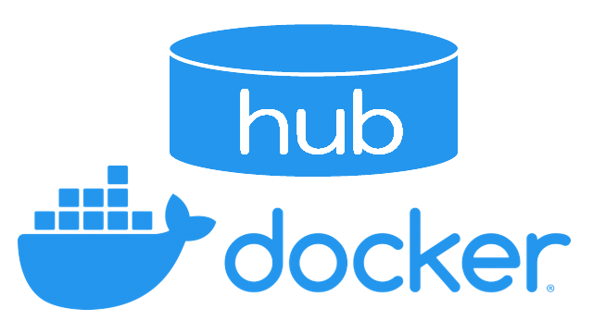
Docker commands for Registry and Hub
// Log in to a docker registry
docker login
// Tag an image for a Docker Registry
docker tag myapp:latest myapp:version1.0
// Push an image to a registry
docker push <image_name>
// Pull an image from a registry
docker pull <image_name>

Slide 23
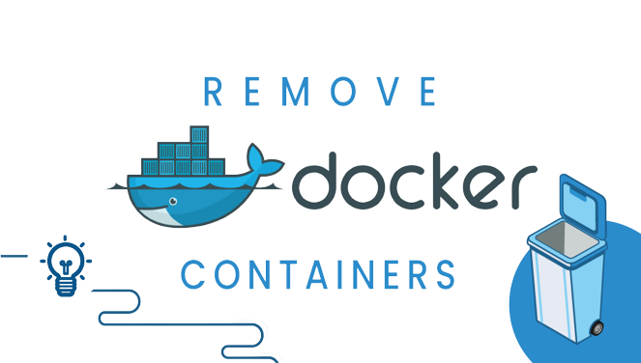
Docker commands for Cleanup
// Remove all stopped containers, unused networks and images
docker system prune
// Remove all stopped containers
docker container prune
// Remove all unused images
docker image prune
// Remove all unused volumes
docker volume prune

Slide 24
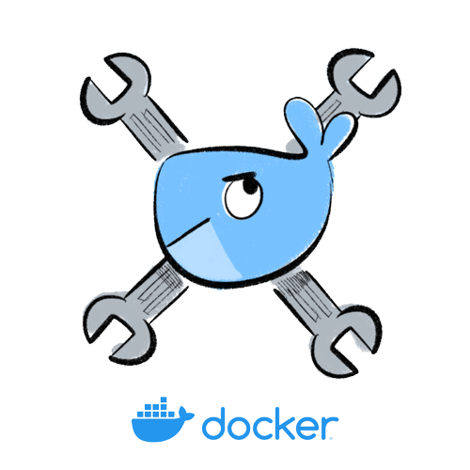
Docker commands for Logs and debugging
// View container logs
docker logs <container_name/id>
// Start an interactive shell in a running container
docker exec -it <container_name/id> /bin/bash
// Display real time container resource usage
docker stats --container_name/id>

Slide 25


Top 8 Docker Best Practices for using Docker in Production
Use official and verified Docker Images as Base Image
Use Specific Docker Image Versions
Use Small-Sized Official Images
Optimize Caching Image Layers
Use .dockerignore file
Make use of Multi-Stage Builds
Use the Least Privileged User
Scan your Images for Security Vulnerabilities

Slide 26


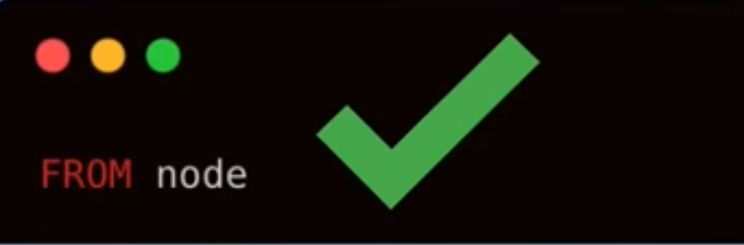
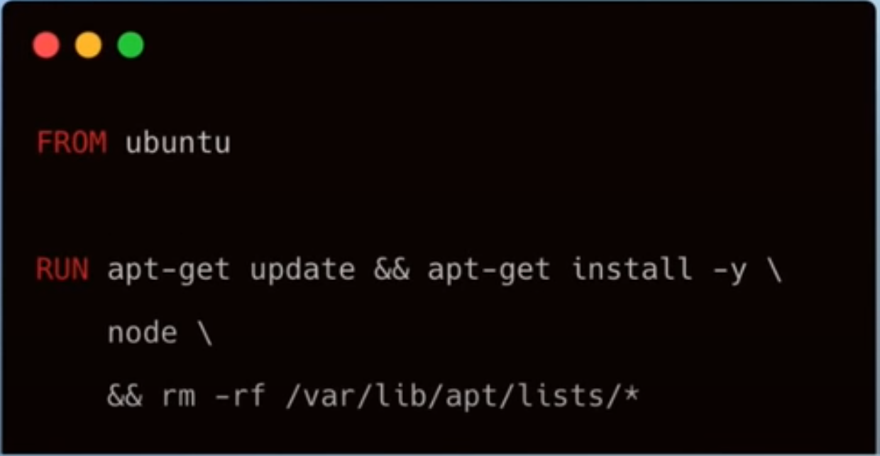
Use official and verified Docker Images as Base Image
Developer
Use official “node” image as base image
Base operating system image
Install packages by yourself
Notes:
When starting with Docker, it's imperative to use official and verified images as your base.
When building a Node.js application with Docker, it’s highly beneficial to use the official Node.js Docker image as your base rather than setting up the environment from scratch. This image comes prepackaged with Node.js and npm, ensuring you have a consistent and reliable setup from the start.
By using the official image, you sidestep the complexities of manual configurations and can immediately focus on your application's development. It’s a time-saver and a best practice that aligns with the Node.js community standards.

Slide 27
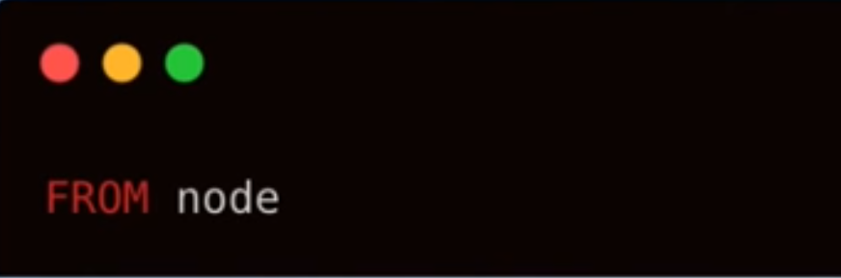
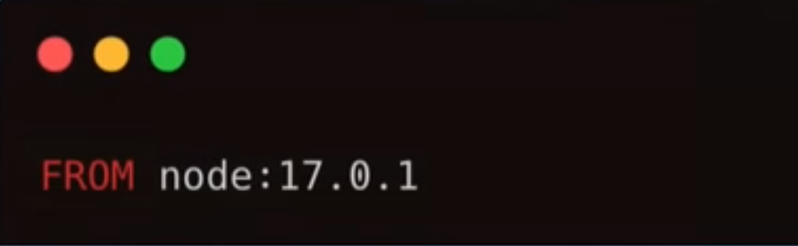
Use Specific Docker Image Versions
Do not use a random latest tag
Fixate the version
It will use the latest tag by default
You might get different docker image versions
Might break stuff
Latest tag is unpredictable
The more specific the better
Gives the team the transparency to know what exact version they are dealing with
Notes:
When deploying Node.js applications with Docker, specifying the exact version of your Docker images is crucial. Avoid using the 'latest' tag. While it might seem convenient, it's unpredictable and can lead to inconsistencies across environments.
By fixing the version, you ensure that every team member and every environment is using the same image, which avoids the 'it works on my machine' syndrome. Specific versions bring transparency and reliability to your workflow, making sure that updates are a choice, not a surprise that could potentially break your application.
Always remember, in Docker, the more specific you are with versions, the better control you have over your deployments

Slide 28
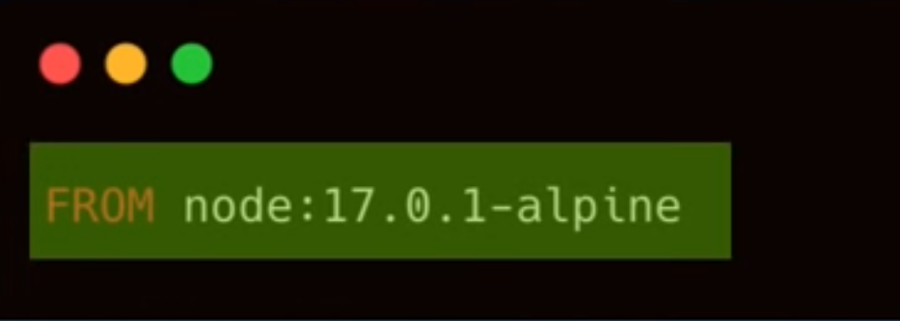


Use Small-Sized Official Images
Could be based on full blown OS
Leaner and smaller operating system distribution
LIghtweight linux distro
System utilities packaged in -> larger image size
Many OS features your image will never use
More security vulnerabilities
Less storage space
Transfer images faster ( pull and push )
Only bundle necessary utilities
Minimize attack surface
Notes:
When selecting an image for your Docker container, choosing a small-sized official image is key. Instead of opting for a full-blown OS, go for a leaner and more lightweight Linux distribution. This practice offers several advantages:
Efficiency: Smaller images take up less storage space and allow for faster transfer rates when pulling and pushing images.
Simplicity: By including only the necessary utilities, you streamline your container's operations.
Security: A minimal image reduces the attack surface, limiting the potential for security vulnerabilities.
Avoid the trap of packing your image with system utilities and features that your application doesn't need. It's not just about saving space; it's about maintaining a secure and efficient container environment for your Node.js application.

Slide 29

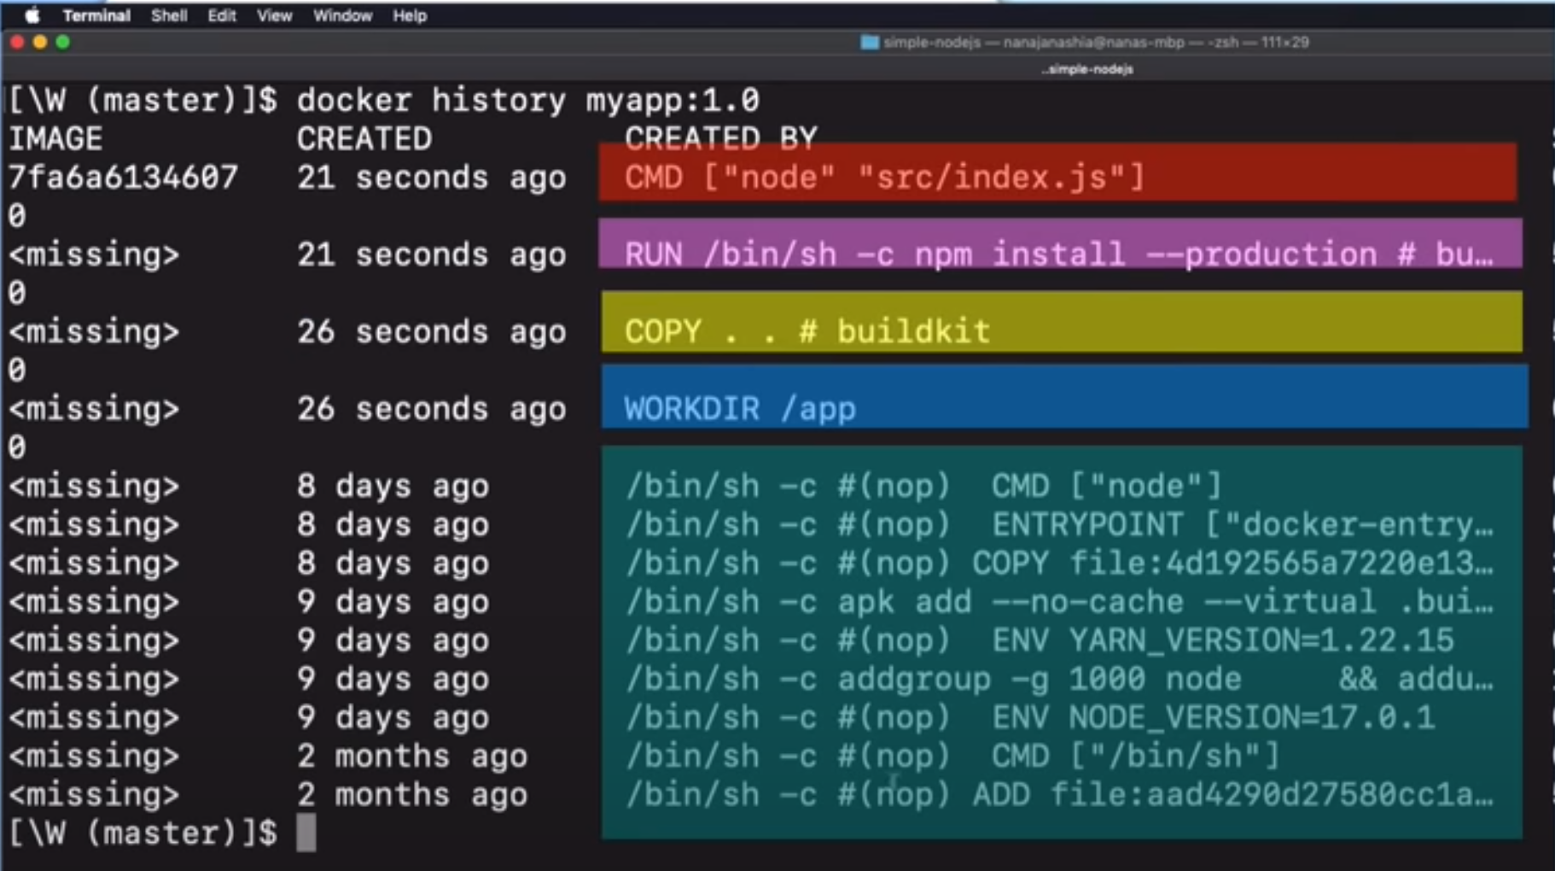
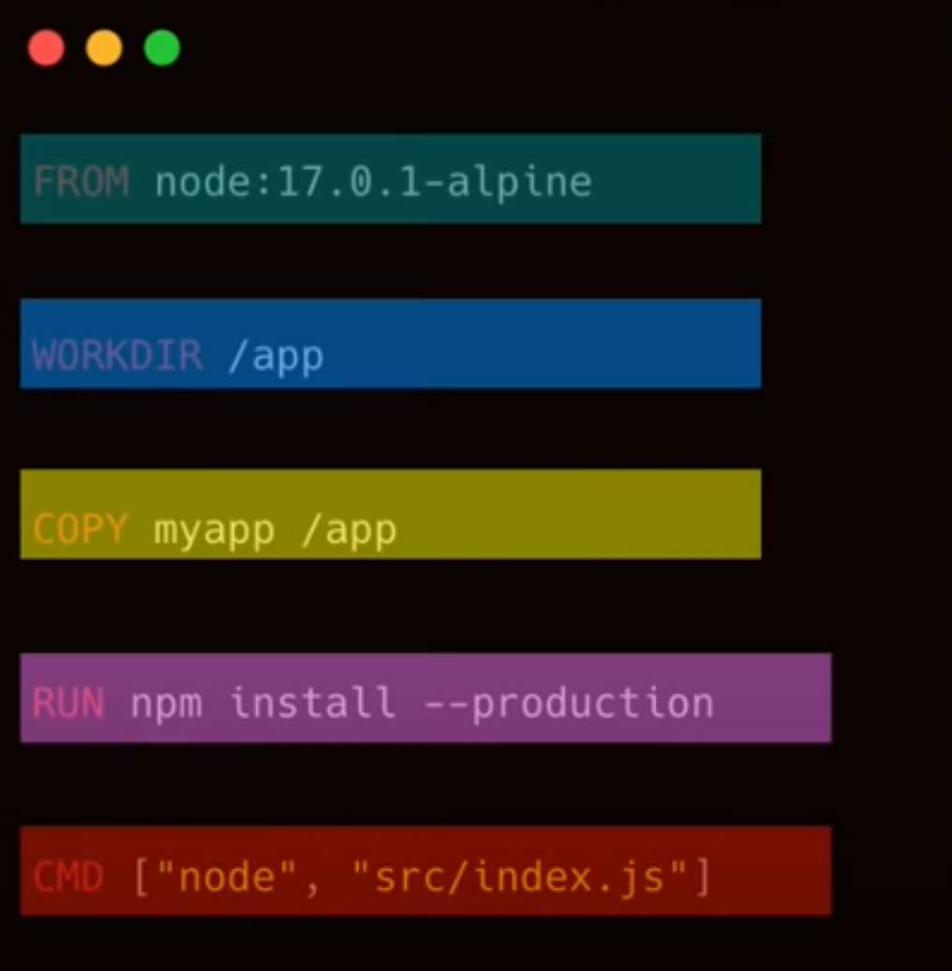
Optimize Caching Image Layers
Notes:
In Docker, each instruction in your Dockerfile creates a layer, and Docker caches these layers to speed up the build process. This cache is a powerful feature that can significantly reduce build time if used correctly.
To visualize this, consider the output of the docker history myapp:1.0 command. It shows the layering of the Dockerfile and how each layer corresponds to a step in the build process. By analyzing this, we can refine our Dockerfiles to optimize for caching and build speed."

Slide 30
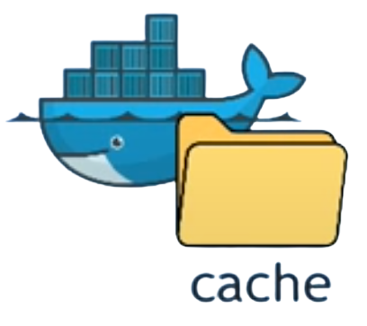
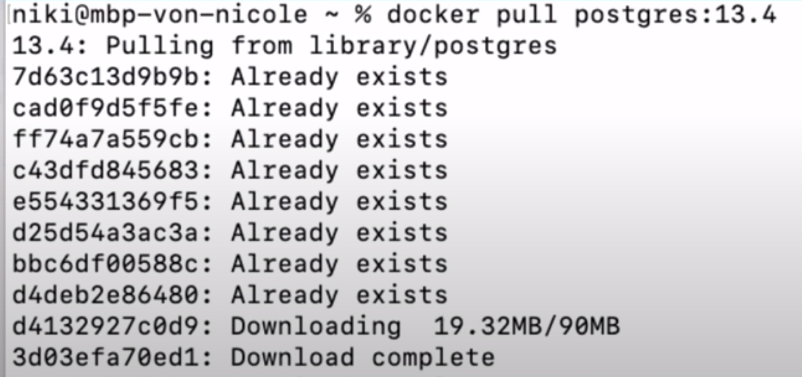
Optimize Caching Image Layers
Docker caches each layer , saved on local filesystem
If nothing has changed in a layer ( or any layers preceding it ) it will be reused from cache
Once a layer changes , all following layers are recreated as well
Faster image building
Downloading only added layers
Notes:
When you build your image, Docker checks each instruction against the cache. If nothing has changed in a layer — and importantly, in any of the layers that come before it — Docker will reuse the existing cached layer. However, as soon as you make a change to a layer, all subsequent layers have to be rebuilt. This is why the order of instructions in your Dockerfile matters. Place instructions that change less frequently at the top and those that change often towards the bottom.
This approach ensures faster image builds because Docker only has to download or recreate layers that have changed. By understanding and utilizing Docker's caching mechanism, we can optimize our build process for speed and efficiency.
Remember, a well-structured Dockerfile is not just about the instructions you include; it's also about their sequence. It's like strategically packing a backpack for quick access — you don't want to repack everything just because you need an item from the bottom.

Slide 31
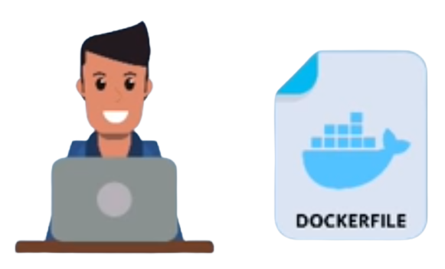
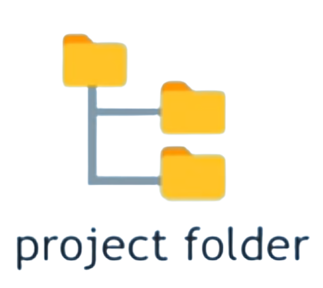
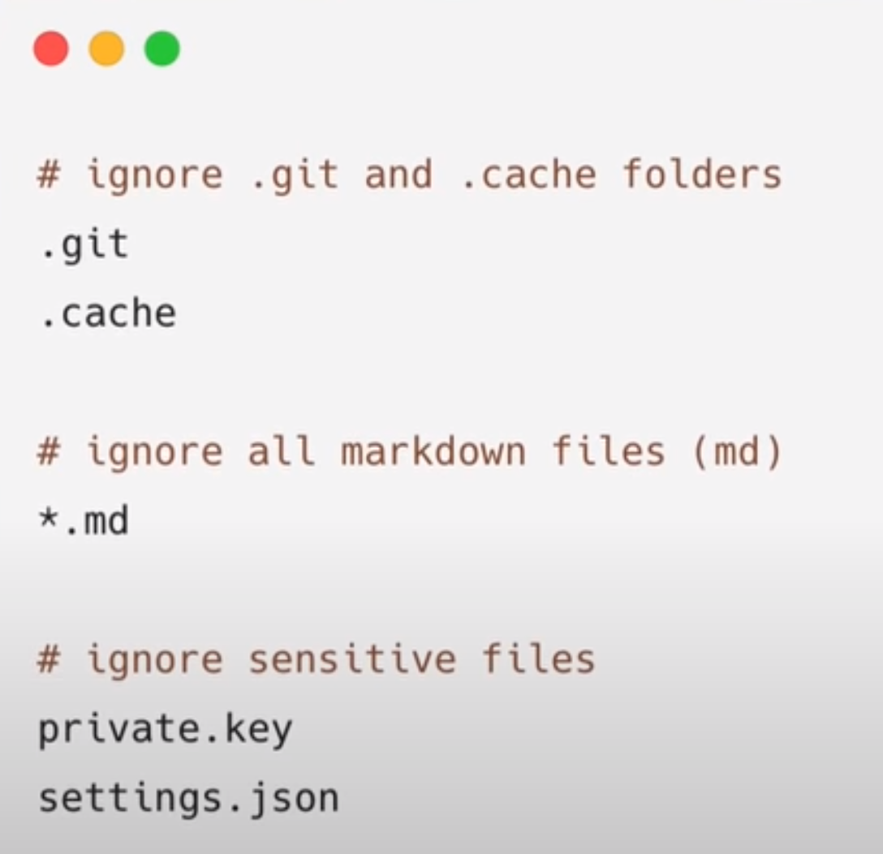
Use .dockerignore file
We don’t need everything inside the docker image like node-modules or README file
docker build -t myapp
Use .dockerignore to explicitly exclude files and folders
Create .dockerignore file in the root directory
List files and folders you want to ignore
Matching is done using Go's filepath.Match rules
Notes:
When building Docker images, especially for production, it's essential to keep them as clean and lightweight as possible. Not everything in your project directory needs to be included in the image. For instance, node_modules or a README file have no place in a production build. This is where the .dockerignore file becomes a critical tool.
By creating a .dockerignore file in the root directory of your project, you can specify which files and directories should be omitted from the Docker context. It's similar to a .gitignore file. You list the items you want Docker to ignore, and these files won't be unnecessarily sent to the daemon when you run docker build -t myapp.
The .dockerignore file not only helps reduce build context size, making your build faster, but it also minimizes your image size and thus reduces the attack surface of your container. The matching patterns used in .dockerignore follow Go’s filepath.Match rules, giving you flexibility and precision in defining what to exclude.
In summary, a well-defined .dockerignore file is a simple yet powerful addition to your Docker practices, streamlining your build process and bolstering your image security.

Slide 32
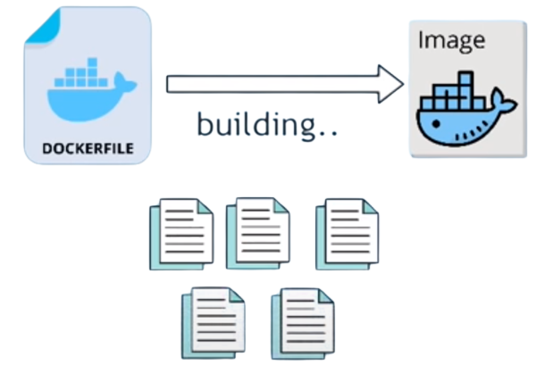
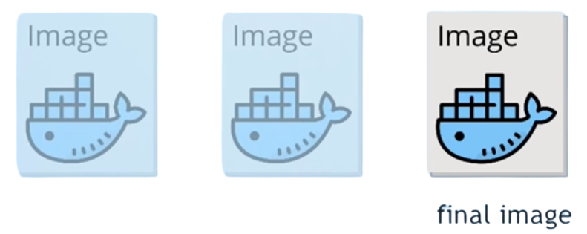
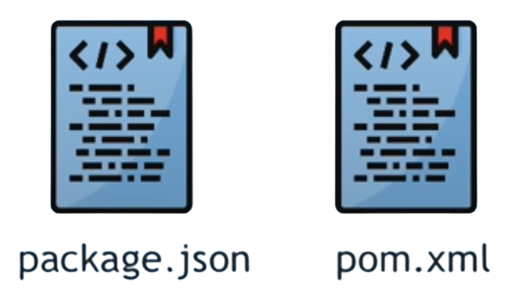
Make use of Multi-Stage Builds
Contents that you need for building the image
Don’t need them in the final image to run the app
Once installed , Not needed for running the app
use multiple temporary images but keep only the latest image as a final artifact
Dependencies files
Notes:
Multi-stage builds in Docker are a powerful feature that allows you to separate the building and running stages of your images. This is particularly useful when you have tools and dependencies necessary for building your application that are not needed in the production environment.
Imagine your Dockerfile as a recipe that includes both the preparation and the final presentation of a dish. In the preparation stage, you might need a variety of ingredients and utensils, but you wouldn’t serve them with the meal. Similarly, in a Dockerfile, the build stage may include compilers, code, and build tools, which are essential for creating your application, but once the app is built, these are no longer necessary.
By using multi-stage builds, you can create a temporary image that includes all these build tools, compile your application, and then in a subsequent stage, copy only the compiled app into a new, clean image. This final image will be devoid of any unnecessary build dependencies, reducing its size and minimizing its attack surface.

Slide 33
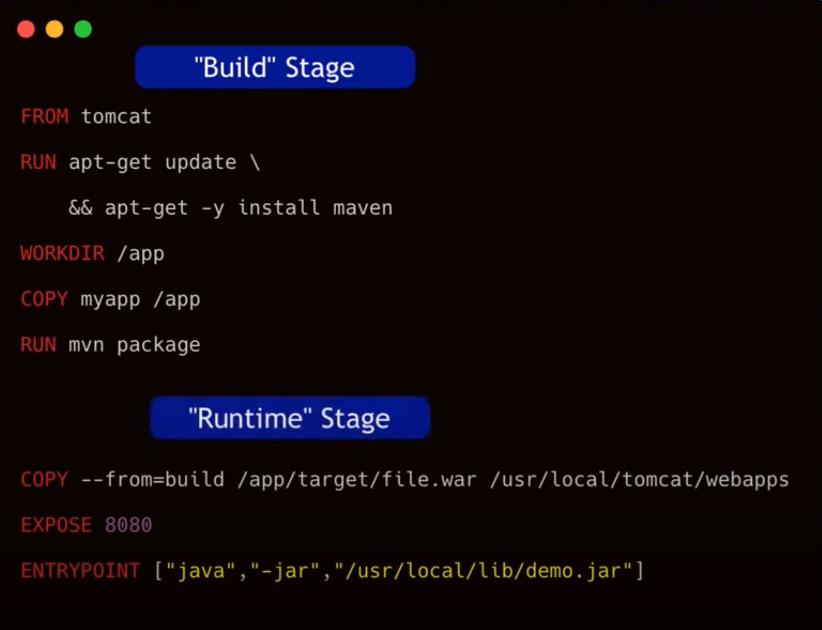



Make use of Multi-Stage Builds
Dockerfile with 2 build stages
How do we exclude the build dependencies from the final image ?
Only the last Dockerfile commands are the image layers
Notes:
To put this into practice, you’d define a build stage in your Dockerfile with all the necessary tools, and then in a later stage, you can copy the results of that build into a fresh image. This is done using the --from=build directive, which tells Docker to pull artifacts from a previous stage.
This technique ensures that only the essential components needed to run your application are included in the final image. It's a clean, efficient, and secure approach to Docker image creation

Slide 34





Use the Least Privileged User
Which OS user will be used to start the application ?
By default if Dockerfile dosen’t specify the user, Docker use the root user
Few use cases, where the container needs to run as root
Security bad practice
Create a dedicated user and group and set the required permissions
Easier privilege escalation for an attacker
Change to non-root user with USER directive
Notes:
In Docker, the principle of least privilege is not just a best practice; it's a necessity for security. When we build a Docker image, it's important to ask ourselves: which operating system user should our application run as?
By default, Docker runs containers as the root user, which carries significant security risks. If an attacker compromises your container, they would have root access to the container, making it easier for them to escalate privileges and potentially cause serious damage.
To mitigate this risk, we should always create a dedicated user with the least privileges necessary for running the application. We do this in our Dockerfile using the USER directive to switch from the root user to this non-root user before the application starts. This simple step can greatly enhance the security of your Docker containers by reducing the potential impact of a breach.
Remember, running as a non-root user is not just a recommendation—it's a critical component of a secure containerization strategy

Slide 35






Scan your Images for Security Vulnerabilities
How to validate the built image for security vulnerabilities ?
Docker uses Snyk for the vulnerability scan
Snyk constantly updates vulnerabilities to a database
Trigger scans automatically when images gets pushed to the docker repo
Notes:
Once our Docker images are built, our job isn't quite done. We must ensure they're secure before going into production. How do we do that? By scanning for security vulnerabilities.
Docker integrates with tools like Snyk to perform these scans. Snyk maintains an up-to-date database of known vulnerabilities, checking your images against this database to identify potential security issues.
The best approach is to automate this process. Set up your CI/CD pipeline to trigger a vulnerability scan each time an image is pushed to your Docker repository. This way, you're not just hoping your images are secure; you're actively verifying it. Regular scanning is essential because vulnerabilities can be discovered at any time, and what was secure yesterday may not be today.
By making scanning a part of your workflow, you're taking a proactive stance on security and ensuring that your Docker images are as safe as possible before they ever reach production.

Slide 36


Looking forward
Unlocking the Power of Container Orchestration
Hands-On Journey with Kubernetes
Notes:
1. Unlocking the Power of Container Orchestration:
Discover the Next Level: “Having mastered Docker, you're now ready to elevate your skills even further. Dive deep into the world of container orchestration, where we'll explore how to efficiently manage, scale, and maintain containerized applications in dynamic and distributed environments.”
2. Hands-On Journey with Kubernetes:
Practical Mastery: “Get ready to roll up your sleeves and immerse yourself in Kubernetes, the leading container orchestration platform. Through hands-on demos and real-world scenarios, you'll gain practical experience and insights, empowering you to confidently orchestrate and optimize your containerized applications.”

